Slide 1
Presentation on Data Analysis (topic 14)
Presented by:
Evaniairihun sohphoh(05)
Prakash Parajuli(23)
MCA 4th semester
St. Anthony’s College,Shillong.

Slide 2
Content
Introduction to Data Analysis
Database Analysis Life Cycle
Data Analysis Process
-Data Requirement
-Data Collection
-Data Processing
-Data Cleaning
-Exploratory Data Analysis
4.Data Analysis For Database
Relational Data Analysis
Multidimensional Data Analysis
Object Oriented Database Data Analysis
5.Data Analysis Techniques
6.Data Analysis Tools
7.References

Slide 3
Introduction to Data Analysis
Data Analysis is a process of
-Inspecting,
-Cleaning,
-Transforming,
-Modeling Data
-with the goal of highlighting useful information, suggesting conclusions, and supporting decision making.
A process to obtain raw data and convert it into information that is useful for a decision maker.
Data analysis is concerned with the NATURE and USE of data

Slide 4
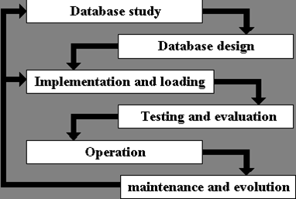
Database Analysis Life Cycle

Slide 5
Cont..
When a database designer is approaching the problem of constructing database system the following step will show the
life cycle of the database.
Database Study:
Here the database designer will creates a written specification in words for the database system to be built. It involves analyzing the problem that may arise, the objectives of the database and also its impact on the company.
Database Design:
In this phase conceptual, logical and physical design step are taken in order to physically implement the required database. It is in this phase where the Entity-Relationship(ER) Model is being created and based on the ER Model, the Entity are being implemented as tables, attributes as the fields of tables and with the help of foreign key we can link between two or more tables.

Slide 6
Cont..
Implementation and Loading:
The implementation phase is where you install the DBMS on the required machine and create the database and the tables and load the data. We can initiate backup plans also in this phase.
Testing and Evaluation:
Once implementation is done, it must be tested against the specification supplied by the client.
Operation:
This step is where the system is actually being use by the company or client.
Maintenance and Evolution:
The database maintenance phase include general maintenance such as :
-Maintaining the tables
-Maintaining the users
-Maintaining Backup and restoration of backup in case of failure
-Changing of the design to meet new requirements

Slide 7
Data Analysis Process
Data analysis process consists of the following phase that are iterative in nature:-
Data Requirement
Data Collection
Data Processing
Data Cleaning
Exploratory Data Analysis

Slide 8
Data Analysis Process
1.Data Requirement:
The data required for analysis is based on the requirements
of those directing the analysis or customers who will use the
finished product of the analysis.
The data necessary as input to the analysis will be identified
Data may be numerical or categorical (i.e., a text label for numbers).

Slide 9
Data Analysis Process
2. Data collection
It is the Process of gathering information based on the requirements
Data is collected from a variety of sources.
Like from sensors in the environment, such as traffic cameras, satellites, recording devices, etc.
It may also be obtained through interviews, downloads from online sources, or reading documentation

Slide 10
Data Analysis Process
3. Data processing
Data initially obtained must be processed or organized for analysis.
For instance, this may involve placing data into rows and columns in a table format for further analysis, such as within a spreadsheet or statistical software.

Slide 11
Data Analysis Process
4. Data cleaning
Once processed and organized, the data may be
-Incomplete
-contain duplicates or
-contain errors
Data cleaning is the process of preventing and correcting these errors.

Slide 12
Data Analysis Process
5. Exploratory data analysis
Once the data is processed, organize and cleaned, it can then be analyzed.
Various data analysis techniques also known as exploratory data analysis are apply or used to understand ,interpret the messages contained in the data.
Data Visualization may also be use to interpret the data in a graphical format

Slide 13
Data analysis for Database
Relational data analysis
Multi dimensional data analysis
Object oriented data analysis

Slide 14
1.Relational data analysis
-Use of tables.
-Relational analysis is about how data can best be organised into
relations.
-For a given dataset, relational analysis will produce a set of tables
(or relations) that between them represent all of the data.
-The object of relational data analysis is to organise all of the data
Items used by the system into a set of well normalised relations.

Slide 15
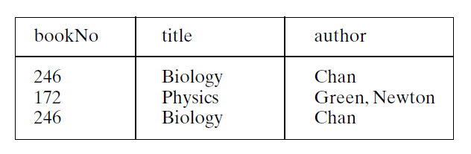

Slide 16
2.Multi-dimensional data analysis
-Multi-dimensional Data Analysis (MDDA) refers to the process of
summarizing data across multiple levels (called dimensions) and then
presenting the results in a multi-dimensional grid format.
-OLAP, Data Pivot., Decision Cube, and Crosstab.
-Three types of dimensions can be defined: Column, Row and Value.
-Column and Row dimensions are used to define summarization level
and Value dimensions are used to specify calculations.

Slide 17
Suppose that our dataset contains the following sales information:
-SalesMonth -State -AmountPaid

Slide 18
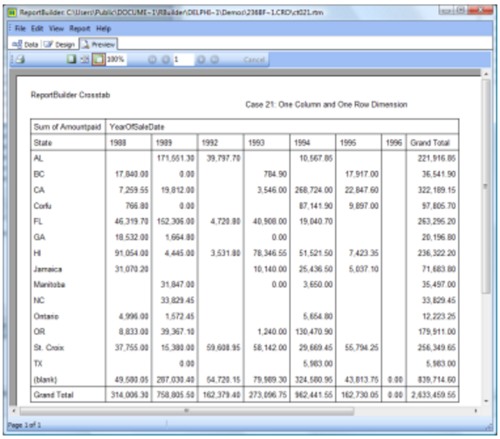

Slide 19
3.Object oriented data analysis
-The main benefit of creating a database with objects as data is
speed. OODBMS are faster than relational DBMS because data isn’t
stored in relational rows and columns but as objects.
-Objects have a many to many relationship and are accessed by the
use of pointers.
-Additionally, object databases lack a formal mathematical
foundation, unlike the relational model, and this in turn leads to weaknesses in their query support.

Slide 20
Data Analysis Techniques
-Data mining is a particular data analysis technique that focuses on:
-Modeling and Knowledge discovery;
-Business intelligence covers data analysis that relies heavily on aggregation, focusing on business information.
-Statistical, linguistic, and structural techniques to extract and classify information from textual sources, a species of unstructured data

Slide 21
Data Analysis Tools
There are a number of documentation tools available for data analysis, some of them are:
ACL(www.acl.com)
SAS (www.sas.com)
Tableau (www.tableausoftware.com)

Slide 22

www.acl.com

Slide 23

SAS (www.sas.com)

Slide 24
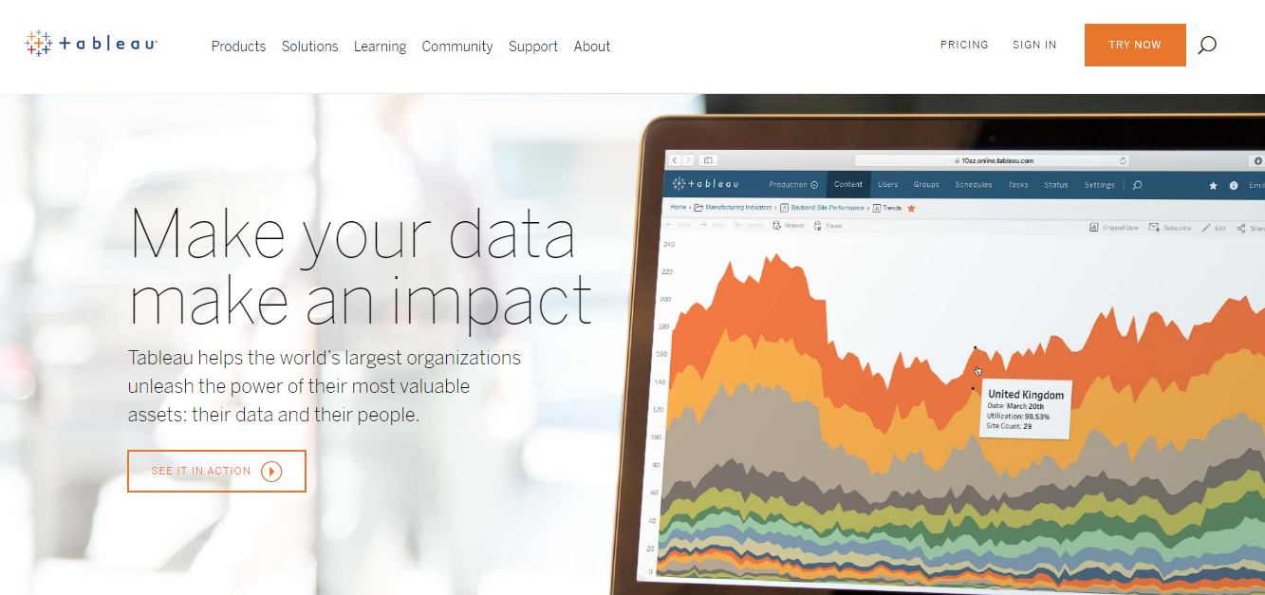
Tableau (www.tableausoftware.com)

Slide 25
Data Analysis Tools
Traditional Programming Languages
-SQL
-C#
-C++
Some Desktop Software
-microsoft excel
-microsoft access
Some utilities software
-textpad
-notepad
-notepad++

Slide 26
References
https://www.technologyuk.net/computing/sad/relational-data-analysis.shtml
https://en.wikipedia.org/wiki/Relational_database
https://www.digitalmetaphors.com/products/multi-dimensional_data_analysis/
https://en.wikipedia.org/wiki/Multidimensional_analysis
https://www.techopedia.com/definition/25827/knowledge-discovery-in-databases-kdd
http://www.webopedia.com/TERM/D/data_modeling.html
https://www.cise.ufl.edu/~ddd/cap6635/Fall-97/Short-papers/KDD3.htm
https://www.tutorialspoint.com/excel_data_analysis/data_analysis_process.htm
http://db.grussell.org/section004.html
http://users.ece.utexas.edu/~valvano/Volume1/E-Book/C7_DesignDevelopment.htm
11. https://archive.ics.uci.edu/ml/datasets/iris

Slide 27
Thank you☺

Slide 28
Back up slides
Data modelling (data modelling) is the analysis of data objects and
their relationships to other data objects.
Knowledge Discovery in Databases is the process of searching for
hidden knowledge in the massive amounts of data that we
are technically capable of generating and storing.
SSADM is a waterfall method for the analysis and design of
information systems. SSADM can be thought to represent a pinnacle
of the rigorous document-led approach to system design, and
contrasts with more contemporary agile methods such as DSDM or
Scrum.

